Slide 1
CMSC 471
Artificial Intelligence
Constraints
Many slides courtesy Tim Finin

Slide 2
General Methods of Solving CSPs
Generate-and-Test, aka Brute Force
Search (backtracking)
Consistency checking
Forward checking
Arc consistency
Domain splitting
Variable Elimination
Localized search

Slide 3
Forward Checking
After variable X is assigned to value v, examine each unassigned variable Y connected to X by a constraint and delete values from Y’s domain inconsistent with v
Using forward checking and backward checking roughly doubles the size of N-queens problems that can be practically solved

Slide 4
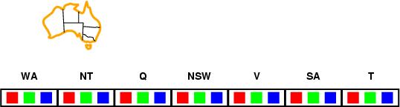
Forward checking
Keep track of remaining legal values for unassigned variables
Terminate search when any variable has no legal values

Slide 5

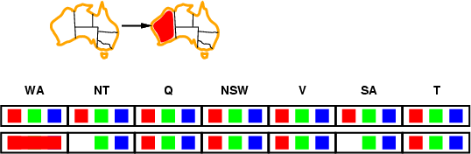
Forward checking

Slide 6
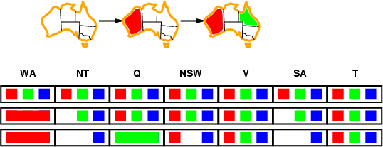
Forward checking

Slide 7

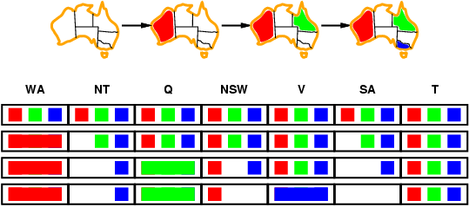


Forward checking
SA (South Australia) domain is empty!

Slide 8






Constraint propagation
Forward checking propagates info.
from assigned to unassigned variables, but doesn't provide early detection for all failures
NT and SA cannot both be blue!
Can we detect
problem earlier?

Slide 9
Definition: Arc consistency
A constraint C_xy is arc consistent w.r.t. x
if for each value v of x there is an allowed value of y
Similarly define C_xy as arc consistent w.r.t. y
Binary CSP is arc consistent
iff every constraint C_xy is arc consistent
w.r.t. x as well as y

Slide 10
AC3 Algorithm: Enforcing Arc Consistency
When a CSP is not arc consistent, we can make it arc consistent by using the AC3 algorithm

Slide 11
Arc Consistency Example 1
Domains
– D_x = {1, 2, 3}
– D_y = {3, 4, 5, 6}
Constraint
x y
C_xy
– Note: for finite domains, we can represent a constraint as an set of legal value pairs
– C_xy = {(1,3), (1,5), (3,3), (3,6)}
C_xy isn’t arc consistent w.r.t. x or y. By enforcing arc consistency, we get reduced domains
– D'_x = {1, 3}
– D'_y={3, 5, 6}

Slide 12
Arc Consistency Example 2
Domains
– D_x = {1, 2, 3}
– D_y = {1, 2, 3}
Constraint
x y
C_xy
– C_xy = lambda v1,v2: v1 < v2
C_xy not arc consistent w.r.t. x or y; enforcing arc consistency, we get reduced domains:
– D'_x = {1, 2}
– D’_y = {2, 3}

Slide 13
Aside: Python lambda expressions
Previous slide expressed constraint between two variables as an anonymous Python function of two arguments
lambda v1,v2: v1 < v2
>>> f = lambda v1,v2: v1 < v2
>>> f
<function <lambda>
>>> f(100,200)
True
>>> f(200,100)
False
at 0x10fcf21e0>
Python uses lambda after Alonzo Church’s lambda calculus from the 1930s

Slide 14
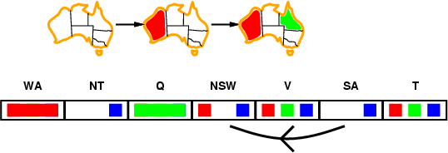
Arc consistency
Simplest form of propagation makes each arc consistent
X ➔Y is consistent iff for every value x_{i} of X, there is some allowed value y_{j} in Y

Slide 15
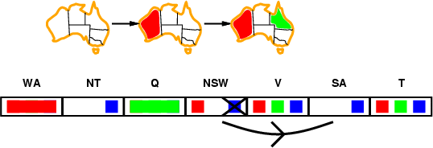
Arc consistency
Simplest form of propagation makes each arc consistent
X ➔Y is consistent iff for every value x_{i} of X there is some allowed value y_{j} in Y

Slide 16
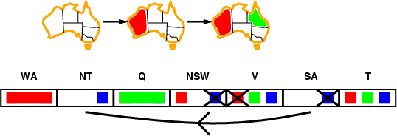
Arc consistency
Arc consistency detects failure earlier than
simple forward checking
WA=red and Q=green is quickly recognized as a deadend, i.e.
an impossible partial instantiation
The arc consistency algorithm can be run as a preprocessor
or after each assignment

Slide 17
General C P for Binary Constraints
Algorithm AC3 contradiction ← false
Q ← stack of all variables

Slide 18
General C P for Binary Constraints
Algorithm AC3 contradiction ← false
Q ← stack of all variables
while Q is not empty and not contradiction do X ← UNSTACK(Q)

Slide 19
General C P for Binary Constraints
Algorithm AC3 contradiction ← false
Q ← stack of all variables
while Q is not empty and not contradiction do X ← UNSTACK(Q)
For every variable Y adjacent to X do

Slide 20
General C P for Binary Constraints
Algorithm AC3 contradiction ← false
Q ← stack of all variables
while Q is not empty and not contradiction do X ← UNSTACK(Q)
For every variable Y adjacent to X do
If REMOVE-ARC-INCONSISTENCIES(X,Y)

Slide 21
General C P for Binary Constraints
Algorithm AC3 contradiction ← false
Q ← stack of all variables
while Q is not empty and not contradiction do X ← UNSTACK(Q)
For every variable Y adjacent to X do
If REMOVE-ARC-INCONSISTENCIES(X,Y)
If domain(Y) is non-empty then STACK(Y,Q)
else return false

Slide 22
General C P for Binary Constraints
Algorithm AC3 contradiction ← false
Q ← stack of all variables
while Q is not empty and not contradiction do X ← UNSTACK(Q)
For every variable Y adjacent to X do
If REMOVE-ARC-INCONSISTENCIES(X,Y)
If domain(Y) is non-empty then STACK(Y,Q)
else return false
Q: What is the time complexity of AC3? e = # of constraints
d = # of values per variable
Slide

Slide 23
General C P for Binary Constraints
e = number of constraints (edges)
d = number of values per variable
Each variable is inserted into stack up to d times
REMOVE-ARC-INCONSISTENCY takes O(d²) time
CP takes O(ed³) time

Slide 24
A Poole & Mackworth Example (Fig 4.4)
Setup: 5 variables (A, B, C, D, E) each with domain {1,2,3,4}
Constraints:
𝐴 ≠ 𝐵
𝐴 = 𝐷
𝐴 ≥ 𝐸
𝐷 ≠ 𝐵
𝐶 ≠ 𝐵
𝐸 < 𝐵
𝐶 < 𝐷
𝐸 < 𝐶
𝐸 < 𝐷

Slide 25
A Poole & Mackworth Example (Fig 4.4)
A
B
Setup: 5 variables (A, B, C, D, E) each with domain {1,2,3,4}
Constraints:
𝐴 ≠ 𝐵
𝐴 = 𝐷
𝐴 ≥ 𝐸
𝐷 ≠ 𝐵
𝐶 ≠ 𝐵
𝐸 < 𝐵
𝐶 < 𝐷
𝐸 < 𝐶
𝐸 < 𝐷
𝐵 ≠ 3
𝐶 ≠ 2
D
C
E

Slide 26
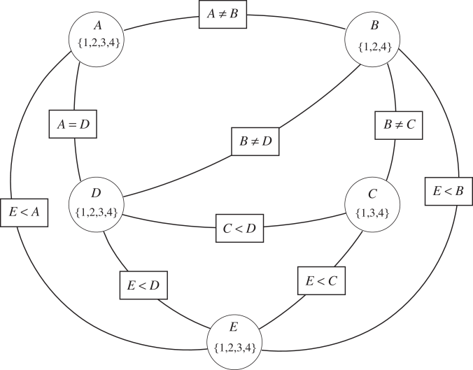
A Poole & Mackworth Example (Fig 4.4)
A
B
Setup: 5 variables (A, B, C, D, E) each with domain {1,2,3,4}
Constraints:
𝐴 ≠ 𝐵
𝐴 = 𝐷
𝐴 ≥ 𝐸
𝐷 ≠ 𝐵
𝐶 ≠ 𝐵
𝐸 < 𝐵
𝐶 < 𝐷
𝐸 < 𝐶
𝐸 < 𝐷
𝐵 ≠ 3
𝐶 ≠ 2
D
C
E

Slide 27
A Poole & Mackworth Example (Fig 4.4)
Setup: 5 variables (A, B, C, D, E) each with domain {1,2,3,4}
Constraints:
𝐴 ≠ 𝐵
𝐴 = 𝐷
𝐴 ≥ 𝐸
𝐷 ≠ 𝐵
𝐶 ≠ 𝐵
𝐸 < 𝐵
𝐶 < 𝐷
𝐸 < 𝐶
𝐸 < 𝐷
𝐵 ≠ 3
𝐶 ≠ 2
Q: Is this arc consistent?
Slide

Slide 28
Improving backtracking efficiency
Some standard techniques to improve the efficiency of backtracking
Can we detect inevitable failure early?
Which variable should be assigned next?
In what order should its values be tried?
Combining constraint propagation with these heuristics makes 1000-queen puzzles feasible

Slide 29

Most constrained variable
Most constrained variable:
choose the variable with the fewest legal values
a.k.a. minimum remaining values (MRV) heuristic
After assigning value to WA, both NT and SA have only two values in their domains
– choose one of them rather than Q, NSW, V or T

Slide 30

Most constraining variable
Tie-breaker among most constrained variables
Choose variable involved in largest # of constraints on remaining variables
• After assigning SA to be blue, WA, NT, Q, NSW and V
all have just two values left.
• WA and V have only one constraint on remaining variables and T none, so choose one of NT, Q & NSW
Slide

Slide 31
Most constraining variable
NT
Q
Tie-breaker among most constrained variables
Choose variable involved in largest # of constraints on remaining variables
WA
SA
NSW
V
T
• After assigning SA to be blue, WA, NT, Q, NSW and V
all have just two values left.
• WA and V have only one constraint on remaining variables and T none, so choose one of NT, Q & NSW
Slide

Slide 32
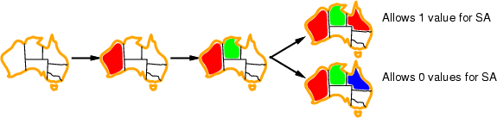
Least constraining value
Given a variable, choose least constraining value:
– the one that rules out the fewest values in the
remaining variables
Combining these heuristics makes 1000 queens feasible
What’s an intuitive explanation for this?

Slide 33
Domain Splitting
Also called “case analysis”
Split a variable’s domain into disjoint subsets,
and consider them each separately

Slide 34
Domain Splitting
Also called “case analysis”
Split a variable’s domain into disjoint subsets,
and consider them each separately
If dom 𝑋_{𝑖} = 𝑎₁, … , 𝑎_{𝑀} , then for each possible setting of 𝑋_{𝑖} = 𝑎_{𝑚}, find an assignment to all other variables that satisfy the constraints
This is solved a reduced problem

Slide 35
Domain Splitting
Also called “case analysis”
Split a variable’s domain into disjoint subsets, and
consider them each separately
If dom 𝑋_{𝑖} = 𝑎₁, … , 𝑎_{𝑀} , then for each possible setting of 𝑋_{𝑖} = 𝑎_{𝑚}, find an assignment to all other variables that satisfy the constraints
This is solved a reduced problem
Q: how does this relate to search?

Slide 36

Domain Splitting Example
Original Domains:
{1,2,3,4}
{1,2,3,4}
{1,2,3,4}
Setup: 3 variables (A, B, C) each with domain {1,2,3,4}
After arc consistency:
{1,2}
{2,3}
{3,4}
Constraints:
𝐴 < 𝐵
𝐵 < 𝐶
Domain Splitting:
B=2
{1,2} | {2} | {3,4}
{1,2} | {3} | {3, 4}
B=3

Slide 37
Domain Splitting Example
Original Domains:
{1,2,3,4}
{1,2,3,4}
{1,2,3,4}
Setup: 3 variables (A, B, C) each with domain {1,2,3,4}
After arc consistency:
{1,2}
{2,3}
{3,4}
Constraints:
𝐴 < 𝐵
𝐵 < 𝐶
Domain Splitting:
B=2, C=3
{1,2}
{2}
{3, 4} ✔
B=2, C=4
{1, 2}
{2}
{3,4} ✔
B=3, A=1
{1, 2}
{3}
{3,4} ✔
B=3, A=2
✔
{1,2}
{3}
{3,4}

Slide 38
Variable Elimination
Simplify the network by incrementally removing variables
– Remove a variable, and create a new constraint on the remaining variables to account for its removal
Slide

Slide 39
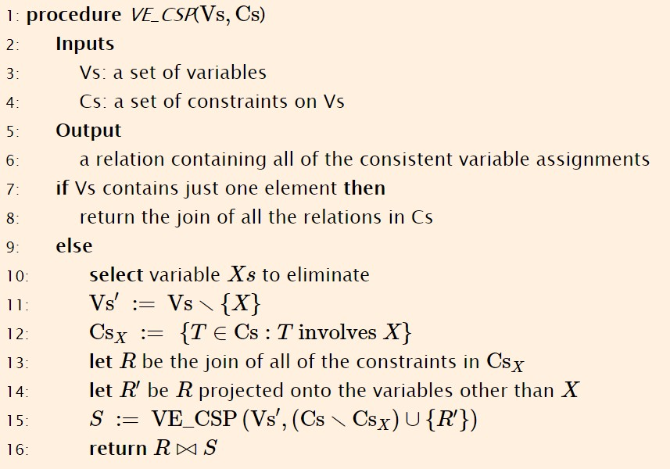
Variable Elimination Algorithm

Slide 40
Variable Elimination Algorithm

Slide 41
Variable Elimination Algorithm
Remove X from the set of variables

Slide 42
Variable Elimination Algorithm
Identify the constraints involving X that need to be reformulated/accounted for

Slide 43
Variable Elimination Algorithm
Based on individual assignments to X, identify the set of
allowed assignments to other variables in those constraints’
scopes
93

Slide 44
Variable Elimination Algorithm
93

Slide 45
Variable Elimination Example
Setup: 3 variables (A, B, C) each with domain {1,2,3,4}
A | B
1 | 2
1 | 3
1 | 4
2 | 3
2 | 4
3 | 4
B | C
1 | 2
1 | 3
1 | 4
2 | 3
2 | 4
3 | 4
Constraints:
𝐴 < 𝐵
𝐵 < 𝐶
Eliminate B

Slide 46
Variable Elimination Example
A B
1 2
B | C
1 | 2
1 | 3
1 | 4
2 | 3
2 | 4
3 | 4
1 | 3
1 | 4
2 | 3
2 | 4
3 | 4
Setup: 3 variables (A, B, C) each with domain {1,2,3,4}
Initial Constraints:
𝐴 < 𝐵
𝐵 < 𝐶
Identify possible, legal combinations. Red rows are not feasible.

Slide 47
Variable Elimination Example
A | B
1 | 2
1 | 3
1 | 4
2 | 3
2 | 4
3 | 4
B | C
1 | 2
1 | 3
1 | 4
2 | 3
2 | 4
3 | 4
Setup: 3 variables (A, B, C) each with domain {1,2,3,4}
Initial Constraints:
𝐴 < 𝐵
𝐵 < 𝐶
A | B | C
1 | 2 | 3
1 | 2 | 4
1 | 3 | 4
2 | 3 | 4
Reformulate constraints/constraint table…

Slide 48
Variable Elimination Example
Setup: 3 variables (A, B, C) each with domain {1,2,3,4}
A | C
1 | 3
1 | 4
2 | 4
Initial Constraints:
𝐴 < 𝐵
𝐵 < 𝐶
Reformulate constraints/constraint table… into one that doesn’t involve B, and solve the simpler problem

Slide 49
Characteristics of Variable Elimination
Depends entirely on the tree-width
Finding a good elimination order is NP-hard (!!!)
Heuristic 1: min-factor: select the variable that results in the smallest relation
Heuristic 2: minimum fill: select the variable that adds the fewest arcs to the resulting graph (don’t make the graph more complicated)

